Slide 1

Educational Game – Capstone
Dilovan Panawandi
Dp19963
Computer Science, Undergraduate

Slide 2



Topics
Introduction to the game
Motivation
Game Design
Technical Implementation
Conclusion & Future Work

Slide 3

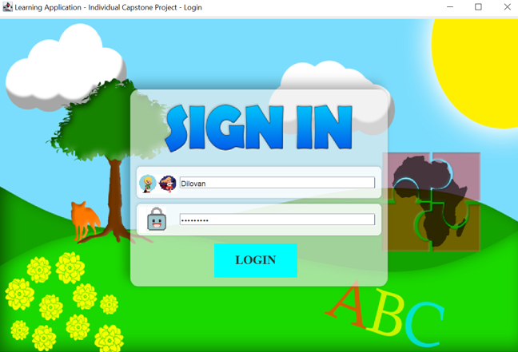
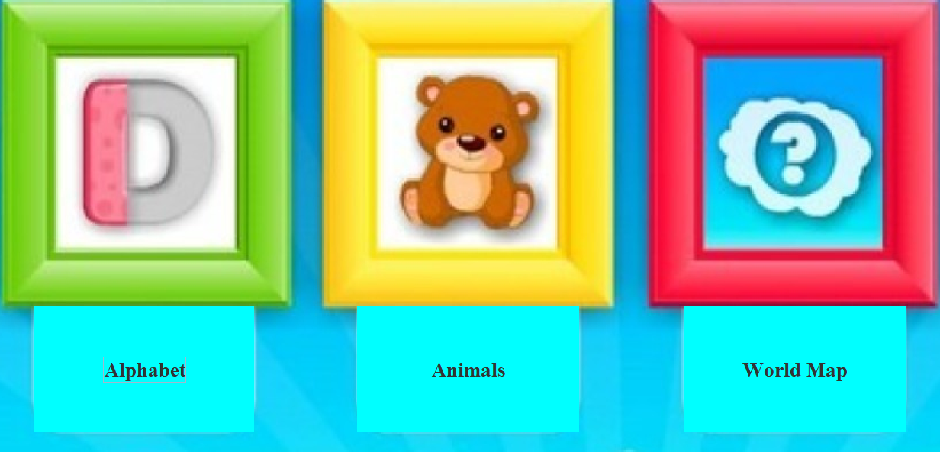

Educational Game for Children
Helping children develop their skills
Three mini-games
Login page with unique ID and password
Level difficulty

Slide 4
Motivation & Inspiration
Memories
Vocabulary, grammar
Skills
Hobby into development
Relevant to the society(useful)

Slide 5
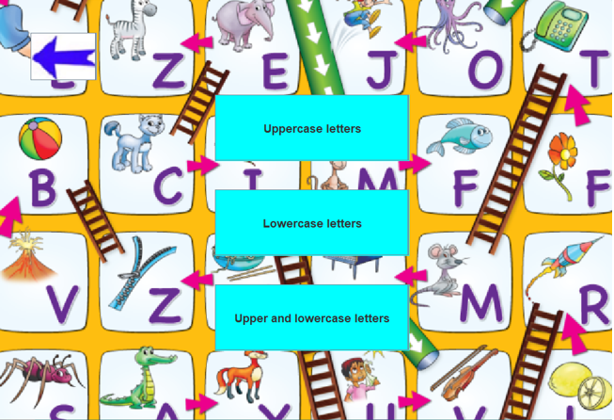
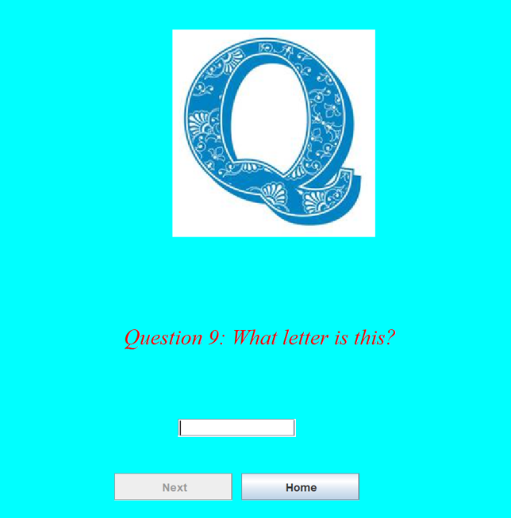
Game Design
Childish
Colourful and positive
Not too distracting
Help and ideas

Slide 6
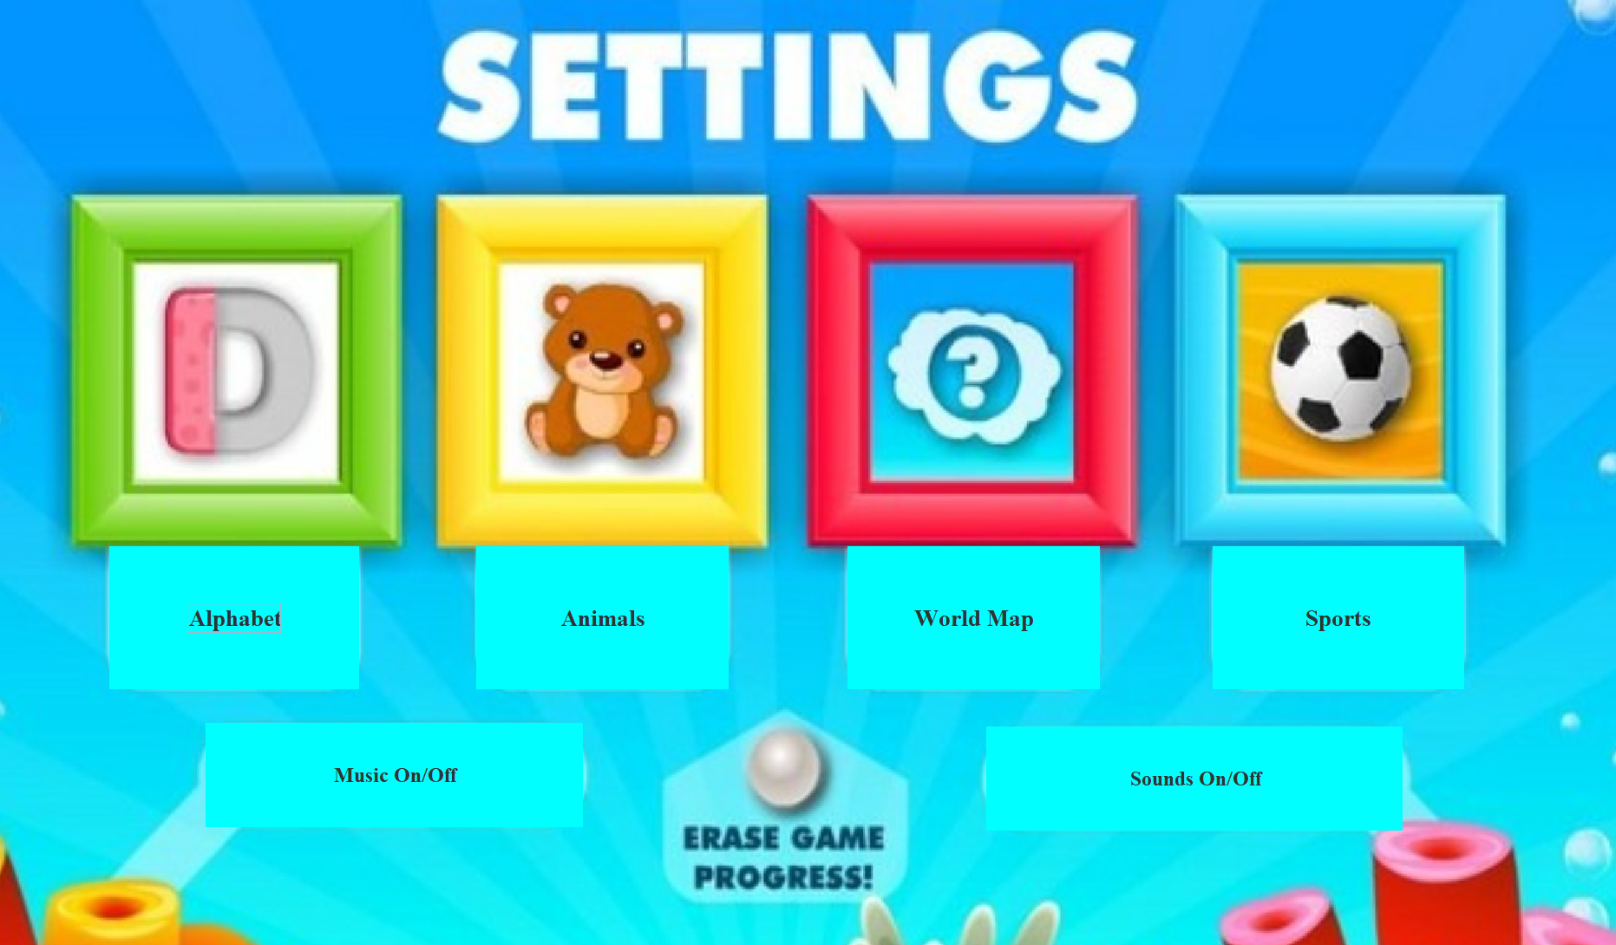
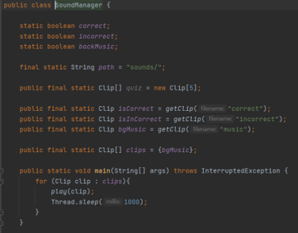
Technical Implementation
Login MySQL
Home Page
Music
Games (next page)

Slide 7
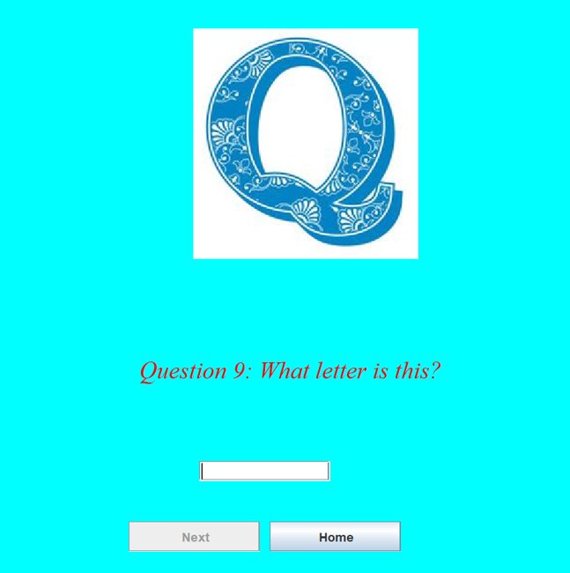
Alphabet Game
Uppercase/Lowercase
Letter input
Next(setEnabled(false))
Home

Slide 8
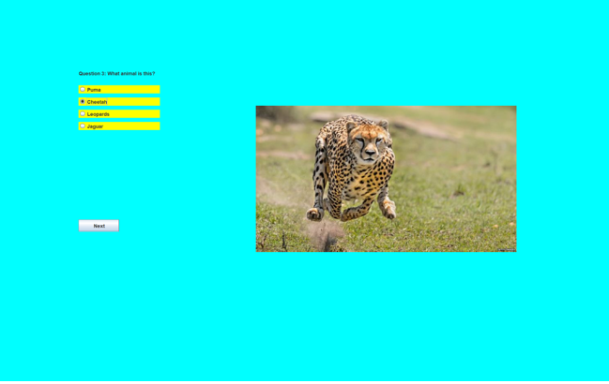
Animal Game
Nine questions
JRadioButtons – Multiple choice questions
Results – nine questions

Slide 9
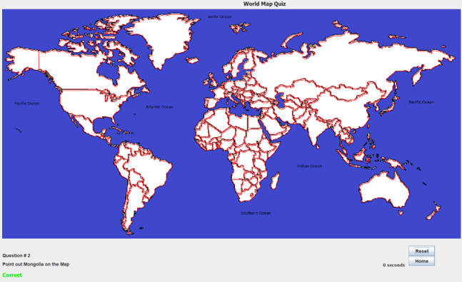
World Map Game
Interactive world map
Fun and easily repeatable
10 Questions and 15 seconds timer.
Reset opportunity

Slide 10
Conclusion & Future Work
Time management
Plans and ideas
Maths minigame
Early testers to fix bugs/errors

Slide 11


Thank you
Educational Game Application 2022
Computer Science
Undergraduate
Dilovan

